Slide 1
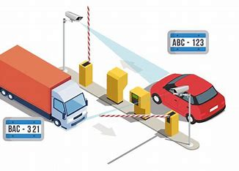
Automatic Number Plate Recognition System
Under the guidance of : Dr. Prakash Ramani
Professor, CSE
Submitted By:
Atul Yadav(219301263)
Raunak Saxena(219310286)
B.Tech CSE

Slide 2
Presentation Agenda
Introduction
Working & Output
Before starting our presentation
Working of project
Background
Pros & Cons
How ANPR came into light
Advantages and Disadvantages
Technology Used
Applications
What Tech has been used?
Keep Various Application touch

Slide 3
Introduction
Automatic Number Plate Recognition (ANPR) systems represent a transformative advancement in modern surveillance and traffic management technologies.
Leveraging a combination of sophisticated hardware and cutting-edge software algorithms, ANPR systems are designed to automatically capture, analyze, and interpret license plate information from vehicles in real-time.
This technology has found widespread application across various sectors, including law enforcement, toll collection, parking management, and border control.

Slide 4
Background
The background of Automatic Number Plate Recognition (ANPR) system traces back to the mid-20th century with its roots in manual license plate identification. Here's a breakdown of its background:
Early Development: The concept of ANPR originated in the 1950s when law enforcement agencies began manually tracking vehicle movements using handwritten notes or photographs of license plates. This method was labor-intensive and prone to errors.
Technological Advancements: The advancement of computer vision and image processing technologies in the late 20th century laid the foundation for automated license plate recognition. Initially, ANPR systems were developed for specific law enforcement and security applications.
Software Development: The development of sophisticated algorithms for image processing, pattern recognition, and optical character recognition (OCR) greatly improved the accuracy and efficiency of ANPR systems. Machine learning techniques further enhanced their performance by enabling systems to adapt and improve over time.
Widespread Adoption: ANPR systems gained widespread adoption in the late 20th and early 21st centuries across various sectors including law enforcement, traffic management, toll collection, parking management, and border control. Governments, transportation authorities, and private companies invested in ANPR technology to improve security, efficiency, and revenue collection.
Jun Akizaki
The Power of PowerPoint | thepopp.com

Slide 5
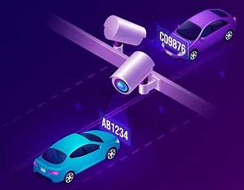
Technology Used
High-Resolution Cameras: Specialized cameras capture clear images of license plates.
Image Processing Algorithms: Analyze images to detect and isolate license plate regions.
Optical Character Recognition (OCR): Extract alphanumeric characters from license plates.
Pattern Recognition: Identify license plate patterns amidst background noise.
Machine Learning: Continuously refine ANPR accuracy and adaptability.
Database Management: Store and manage captured license plate data efficiently.
Integration with Other Systems: Interface with GPS, GIS, and surveillance systems for enhanced functionality.
Networking and Communication: Facilitate real-time data transmission and remote access for seamless operation.

Slide 6




Software Used
Jupyter Notebook
Python
Open CV
Tensor Flow
MySQL

Slide 7
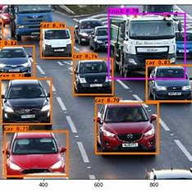
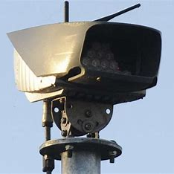
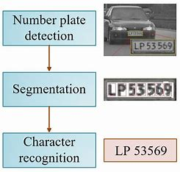
Working
Detection Of Vehicle
Capture of Images
Process of Recognition
The vehicle approaches on the road or on the secured area and the camera captures its image.
The ANPR unit activates the illumination and takes picture of front and rear plates using ANPR camera.
The ANPR unit checks if the vehicle appears on a predefined list of authorized cars and if it found its signals to open the gate.

Slide 8
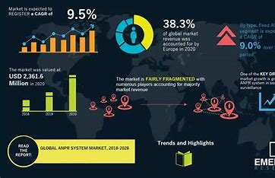
Goal of ANPR
Detected License Plate: The alphanumeric characters of the license plate are identified and extracted from the captured image or video frame.
Vehicle Information: Additional information about the vehicle, such as its make, model, color, and size, may be included in the output if available or relevant.
Location Data: The geographic location where the license plate was detected (e.g., GPS coordinates or a description of the location) is often provided to support geospatial analysis or mapping.
Alerts or Notifications: Depending on the system's configuration, alerts or notifications may be generated based on specific criteria, such as detecting a vehicle of interest or identifying a license plate associated with a known incident or violation.

Slide 9

ANPR (In App Features)
E-Chalans
Geo-Tagging and Mapping
It enables to see your chalans when you break traffic rules, do over speeding etc.
Provides geotagging functionality to track and map the locations of detected vehicles.
Database Integration
Integration with Other Systems
Enables integration with existing databases for cross-referencing against lists of vehicles of interest, such as stolen vehicles or suspects.
Offers integration capabilities with other security or management systems, such as access control or parking management systems.

Slide 10



Pros & Cons
Advantages
Disadvantages
Enhanced Security
Efficient Law Enforcement
Reduced Manual Labor
Parking Management
Enhanced Public Safety
Privacy Concerns
High Costs and Maintenance
Technical Limitations
Legal and Regulatory Challenges
Social Acceptance

Slide 11
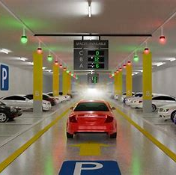
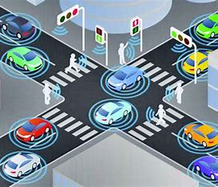

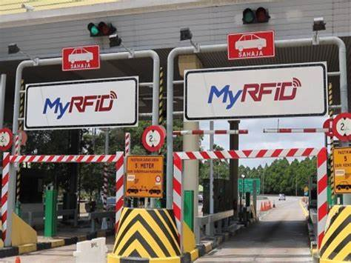
Applications
Parking
Traffic Control
Stolen Cars
Tolling
Some parking applications allow users to reserve parking spaces in advance, particularly in busy areas or during events. This ensures that drivers have guaranteed parking.
In case of traffic rule violations such as speeding or going through a red light, the camera can capture the offender’s plate number, which can be later used for enforcement.
When an ANPR system scans a license plate associated with a stolen vehicle, it triggers an immediate alert, facilitating quick recovery and deterring car thieves
The toll fee is automatically deducted from the account of the owner of car thus it provides hassle free movements in toll area.

Slide 12




Conclusion
Benefits
Advancement
It include enhanced security, improved traffic flow, and increased convenience for users.
(ANPR) technology represents a significant advancement in surveillance and traffic management.
Challenges
Smarter Ecosystem
It include privacy concerns, accuracy issues, and regulatory compliance requirements.
Responsible deployment and continued advancements can harness the potential of ANPR for creating smarter and safer communities.

Slide 13
Thank You

